Slide 1
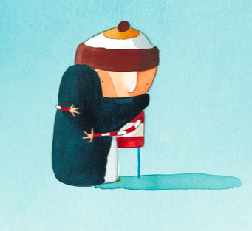
Developing Emotions
Unit 6
Friendship

Slide 2
Lesson 1. That’s What Friends Are For
In this lesson, we are going to talk about what makes a good friend.
We are going to learn about friendship, evolution, and our brains.
Then we will have a go at making our own recipes for friendship.

Slide 3
That’s What Friends Are For
Have you seen The Jungle Book? Put your hand up if you have!
We’re going to watch a short clip from the original Disney film.
Listen out for all the things friends do for each other.

Slide 4
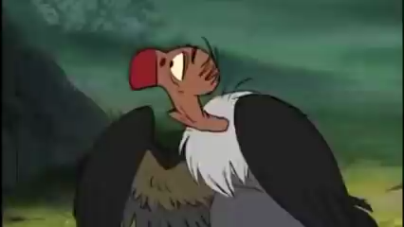

Slide 5
That’s What Friends Are For
Now it’s your turn!
Look at your lyric sheet.
Can you underline all the things in the song that friends do for each other?

Slide 6
Survival of the Friendliest
Humans and primates (apes) have very big brains compared to other animals.
Who can suggest why?
Scientists say:
Humans and primates are very social animals, who live in groups of family and friends.
Building relationships need a lot of brainpower! Over time, this has led humans to develop their big brains.

Slide 7
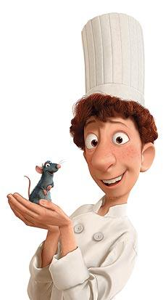
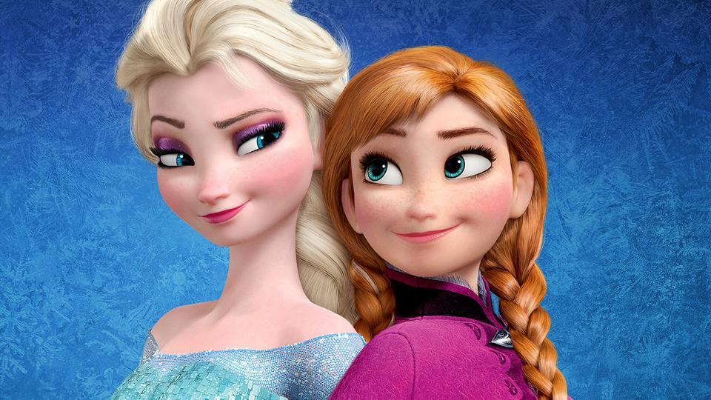
Some Famous Friendships

Slide 8
What makes a good friend?
What words would you use to describe a good friend?
How does a good friend act?
Discuss with your partner for 2 mins

Slide 9
What makes a good friend?
Now it’s your turn!
Have a look at your ‘friendly adjectives’ worksheet.
Put a tick next to three that you think are important
Put a question mark next to three words you haven’t seen before.

Slide 10
A recipe for friendship
We’re going to write a recipe for friendship on our worksheets.
What ingredients do you need? Turn some friendly adjectives into nouns.
Then make sure the ingredients add up to 25kg:
That’s how much an average year 3 pupil weighs!

Slide 11
Developing Emotions
Unit 6
Friendship

Slide 12
Lesson 2. Friend Book
In today’s session, we are going to look at proverbs.
We will have a go at writing our own.
We are going to learn about ‘friendship books,’ and create one for the class!

Slide 13

Proverbs
A proverb is a short saying or statement about the world.
Proverbs often offer important advice about life.
Many proverbs come from religious texts, such as the Bible and the Qur’an.
Different cultures around the world have their own proverbs.

Slide 14

Proverbs
We are going to look at some proverbs from around the world.
Have a look at your ‘friendship proverbs from around the world’ worksheet.
Which proverbs do you agree with?

Slide 15
Friendship Proverbs
‘A friend in need is a friend indeed.’
‘Friendship is a plant we must often water.’
‘If you make friends with a pig,
you must be prepared to live in the mud.’

Slide 16
Friendship Proverbs
Now it’s your turn!
We are going to write our own friendship proverbs.
Can you write something true about friendship in a short, punchy sentence?

Slide 17
Album Amicorum (‘a book of friends’)
Album Amicorum is Latin for ‘a book of friends.’
In the 16th century (500 years ago!), university students carried round a ‘book of friends.’
The book was filled with messages, poems and drawings from their friends, teachers and other students.
It was a bit like Facebook, but before the internet!

Slide 18
Album Amicorum (a ‘book of friends’)

Slide 19
Album Amicorum (a ‘book of friends’)

Slide 20
Album Amicorum (a ‘book of friends’)
Now it’s your turn!
We are going to make our own class book of friends.
In pairs, work together to complete your ‘Friendbook’ worksheets.
Make sure your portrait is colourful!
Which proverbs will you choose for your partner?

Slide 21
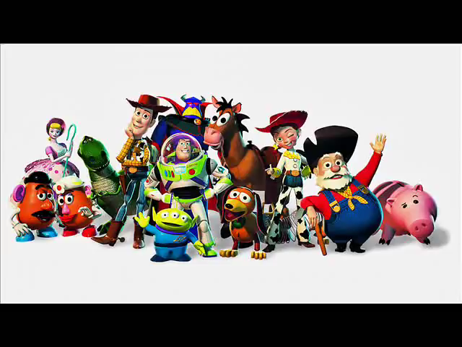
‘You’ve got a friend in me’

Slide 22
Developing Emotions
Unit 6
Friendship

Slide 23


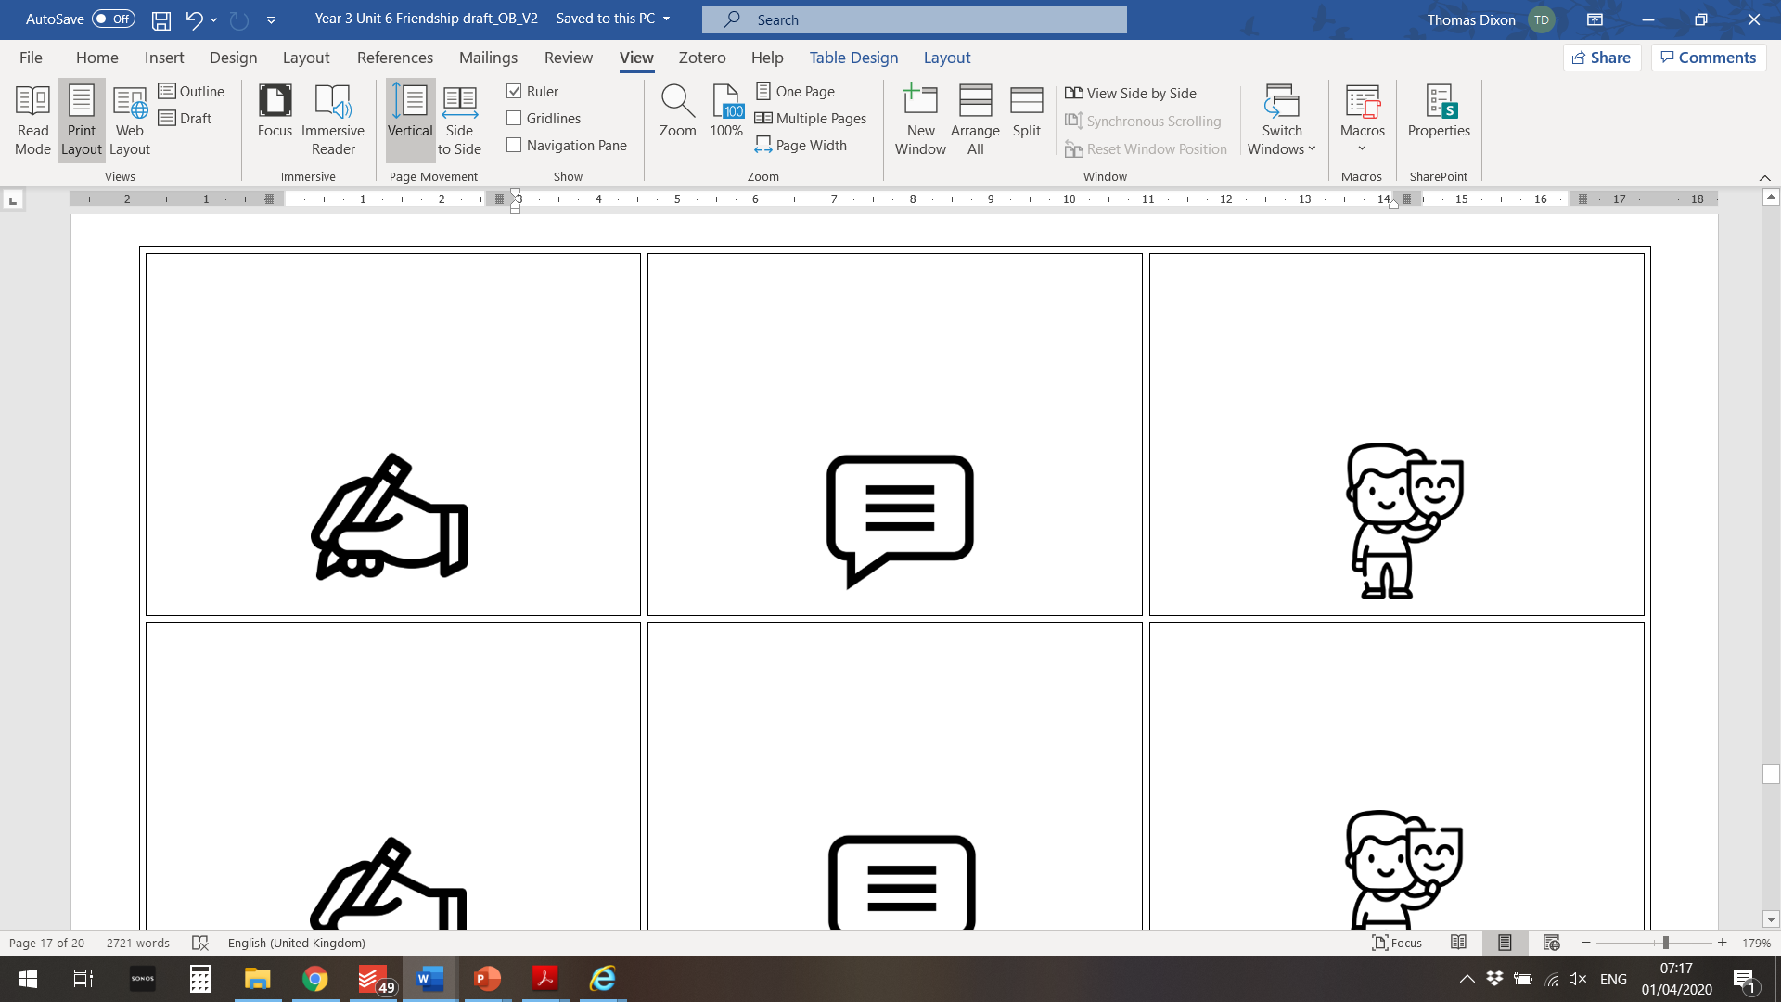
Lesson 3. Developing Emotions
This is the last lesson of Developing Emotions.
We’re going to play a game called Emotionology!
Then we will take some quizzes to show how much we have learned about feelings and emotions.
At the end you will receive a certificate because you are now an expert on emotions!

Slide 24
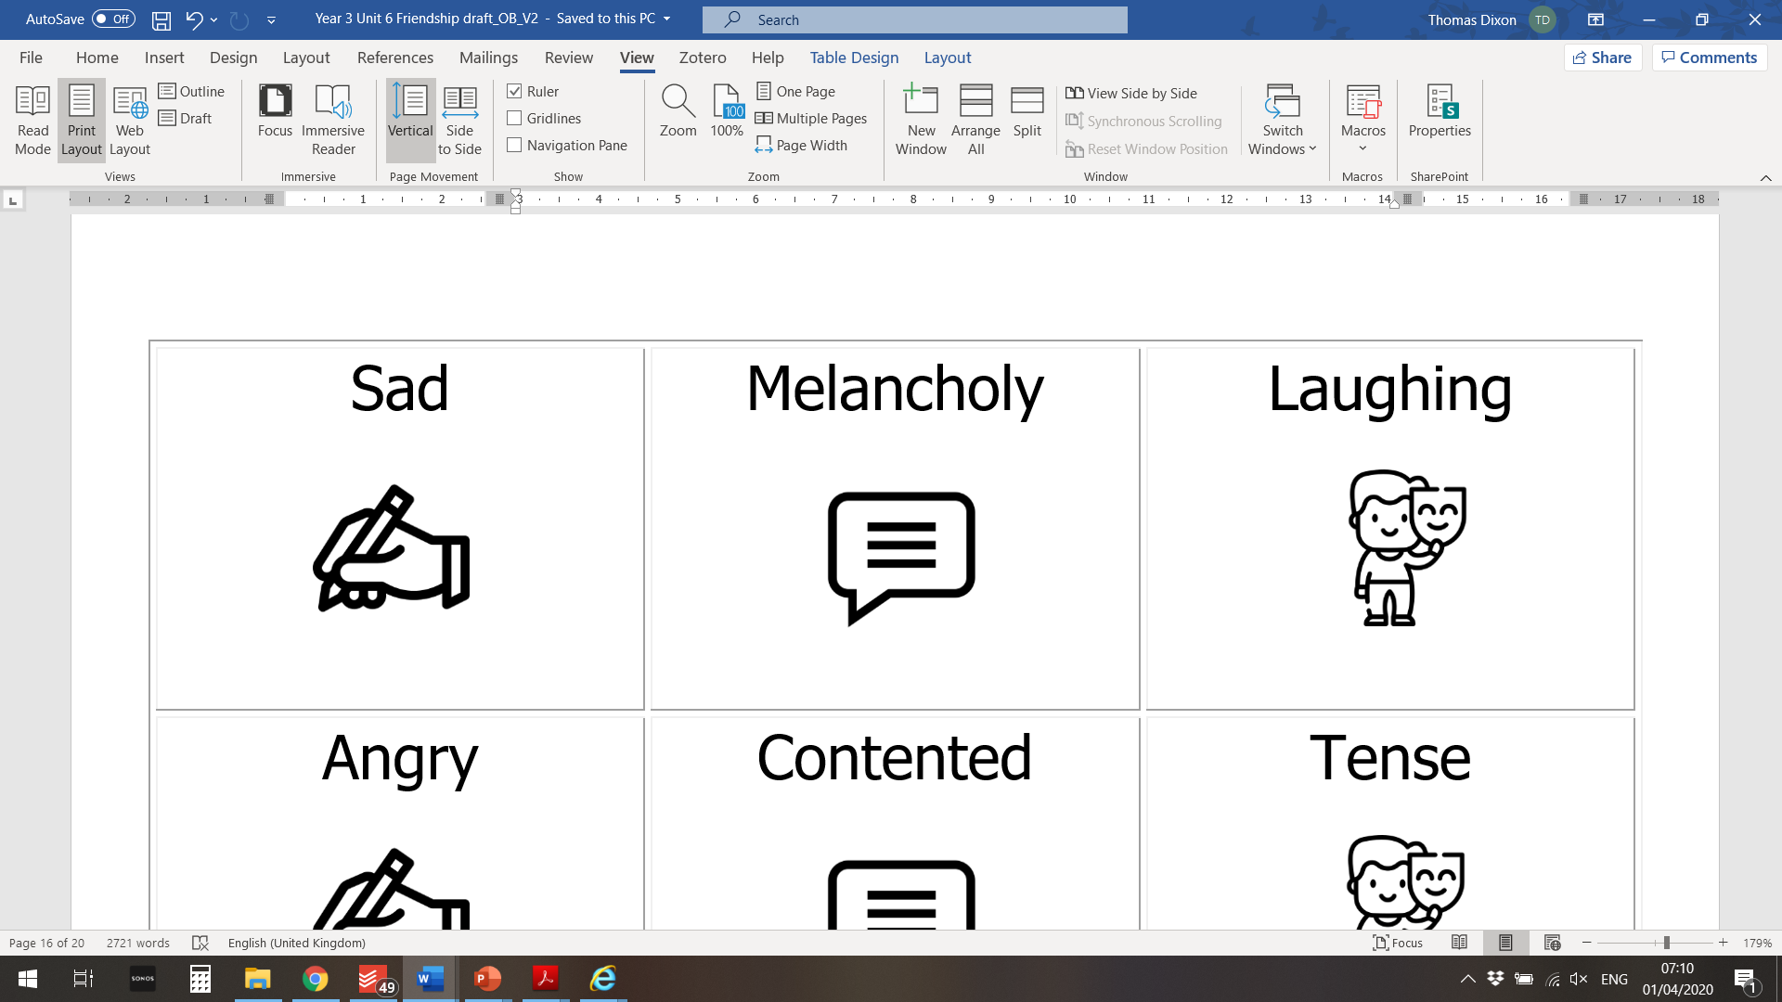
Let’s play EMOTIONOLOGY – The Game of Feelings!
In this game you are going to draw, describe, or act out different feelings and emotions for your team-mates to guess.
But first, we need to prepare the materials.
On your table you have a set of cards which each have a heart symbol on the back.
Some have emotion words and symbols written on them like the ones on this slide.

Slide 25
Let’s play EMOTIONOLOGY – The Game of Feelings!
Some of the cards are blanks - they have a symbol but no word – like the ones pictured here:
Share the blanks out in your group and write a word for an emotion or feeling on each one.
It could be something simple like happy or something more unusual, like petrified, ecstatic, or raging.

Slide 26
Let’s play EMOTIONOLOGY – The Game of Feelings!
Now your emotion cards are ready.
Place them all in a single pile, face-down.
In your group, each player will take a turn to take a card from the top of the pile. Don’t show your card to anyone else! And don’t say the word!
Then you have to describe draw or act out
the word on your card.
If you don’t know the word, that’s fine – just put it to the bottom of the pile and take another one!

Slide 27
Let’s play EMOTIONOLOGY – The Game of Feelings!
When an emotion is guessed correctly, it’s the next person’s turn to take a card and have a go.
Ready to play?
When your teacher says ‘Go!’ you will have five minutes to guess as many emotion words as possible.
Go!!

Slide 28
Let’s play EMOTIONOLOGY – The Game of Feelings!
Which group guessed the most emotion words?
Were some particularly tricky?
Was it easier to describe, draw, or act out the emotions?

Slide 29

Final quizzes
Now you have finished the
Developing Emotions
lessons, it is time to take two final quizzes to see what new words and feelings you have learned!

Slide 30
Conclusions
We hope the Developing Emotions lessons have been fun and informative!
You have seen that there are hundreds of different emotions!
We can express them in words, actions, music, movement, colours and images.

Slide 31
Conclusions
A happy life is full of laughter, joy and, and friendship…
…but there’s room for other emotions too, like sadness or worry, which we will all sometimes feel.
Learning to name our feelings can help us celebrate them…
and also to control and understand them.

Slide 32


Thank-you for completing these lessons!
You are now a certified emotional expert
Congratulations!

